Slide 1
IBM University Engagement Project Submission
“Exploring the Power of Agentic AI with IBM Granite and IBM Bob”

Slide 2

Project Tile – [ResearchPilot AI – Research Agent]
Domain of Project – [ Education / Research ]
Student Name
Recent Passport Photo
Email ID
Mobile number [WhatsApp]
Sam
samikshayadav308@gmail.com
8197275488

Slide 3
Problem Statement -
Problem Statement : Research Agent
The Challenge
Researchers and students often deal with scattered research papers, articles, PDFs, notes, and data across multiple sources. Finding relevant literature, comparing multiple papers, and synthesizing findings takes real effort. Without systematic gap detection and direction-finding, identifying research gaps and future directions can be time-consuming and difficult.
Research Paper Aggregation – Collect and organize relevant papers, articles, PDFs, and research materials from multiple sources.
PDF & Multimodal Input – Work directly with PDFs, notes, charts, and other research material as input.
Literature Synthesis – Analyze and synthesize findings across multiple research papers into a coherent summary.
Grounded Research Q&A – Answer questions using information retrieved from the uploaded research documents.
Multi-Agent System –
Paper Comparison Agent (compares papers by methods, findings, and datasets)
Research Gap Agent (surfaces emerging trends and unexplored research gaps)
Research Direction Agent (recommends promising future research directions)
Literature Review Agent (drafts structured literature reviews from the paper set)
Research Visualization – Visualize topic clusters, citation relationships, trends, and knowledge graphs across the paper library.
The Objective
Build an AI-powered Research Agent that acts as an intelligent research companion for researchers and students. The solution should help users:

Slide 4
Proposed Solution -
Proposed Solution: AI-Powered Research Agent
The proposed solution is a multi-agent AI-powered Research Agent built using IBM Bob for orchestration, with an optional IBM watsonx.ai + Granite backend to help researchers and students work through scattered literature. The system addresses challenges in paper aggregation, synthesis, comparison, and gap discovery through an intelligent, modular architecture. Granite is not connected in the current build, so the agent runs in a fully-functional local Demo Mode by default.
At its core, the solution uses a Retrieval-Augmented Generation (RAG) pipeline that extracts text from uploaded PDFs with PyMuPDF, chunks it, and embeds it with a sentence-transformers model. The embeddings are stored in a FAISS vector index (with a TF-IDF fallback), enabling the system to retrieve the most relevant passages and ground every answer in the source papers.
The system consists of six key agents:
Paper Analysis Agent extracts metadata, topics, methods, and datasets from every uploaded paper.
Research RAG Agent retrieves the relevant evidence and generates grounded, cited answers to research questions.
Paper Comparison Agent produces a structured, side-by-side comparison of papers by methods, findings, and datasets.
Research Gap & Direction Agent highlights unexplored areas and limitations, and suggests promising future research directions.
A sixth, the Literature Review Agent, drafts a structured literature review section by section. The solution also includes a user-friendly dashboard (built with Flask and vanilla JS) that visualizes the paper library, chat interface, comparisons, gaps, and the research landscape map.
IBM Bob is used to orchestrate the agent workflow end to end. Where watsonx.ai/Granite credentials are available, Granite powers the reasoning and generation steps; otherwise every agent falls back to deterministic, fully offline logic so the app stays usable without any cloud credentials.
Overall, this solution delivers an end-to-end intelligent research assistant that turns a scattered pile of papers into organized, grounded, and comparable knowledge.

Slide 5
Technology Used
1
IBM Bob platform
2
IBM Granite model
3
IBM Cloud
For designing and orchestrating the multi-agent research workflow visually
for eg – ibm-granite-3-2-8b – for summarization, comparison, and Q&A reasoning (not connected in this build; app runs in local Demo Mode)
Provides the infrastructure to build, deploy, and scale the Research Agent efficiently. IBM Cloud enables a reliable, secure, and scalable environment for deploying the Research Agent.
4
RAG
5
IBM Watsonx.ai
6
Vector Database
RAG to fetch real evidence from the uploaded papers first, then generate grounded answers, making the Research Agent’s answers traceable and trustworthy.
For optional model deployment, embeddings, and AI governance (not connected in this build)
(FAISS, with a TF-IDF fallback) – For RAG-based retrieval over paper chunks

Slide 6
Required Files in the Research Agent (ResearchPilot AI) project -
app.py – Flask backend and API routes
1
requirements.txt – Python dependencies
2
agents.py – the six research agents
3
rag.py – PDF extraction, chunking, FAISS index
4
templates/index.html + static/style.css + static/app.js – dashboard UI
5

Slide 7
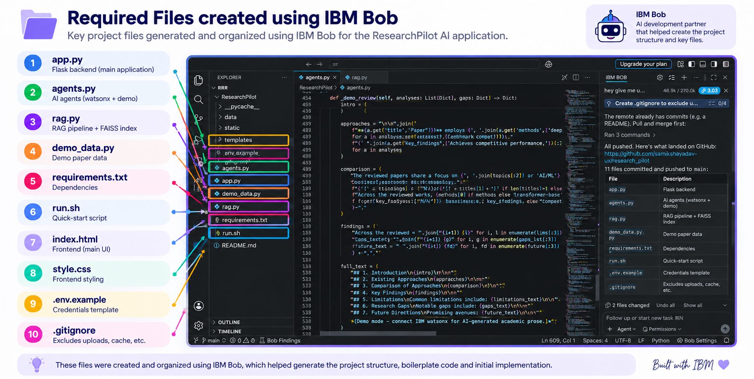
IBM Bob Screenshots:

Slide 8
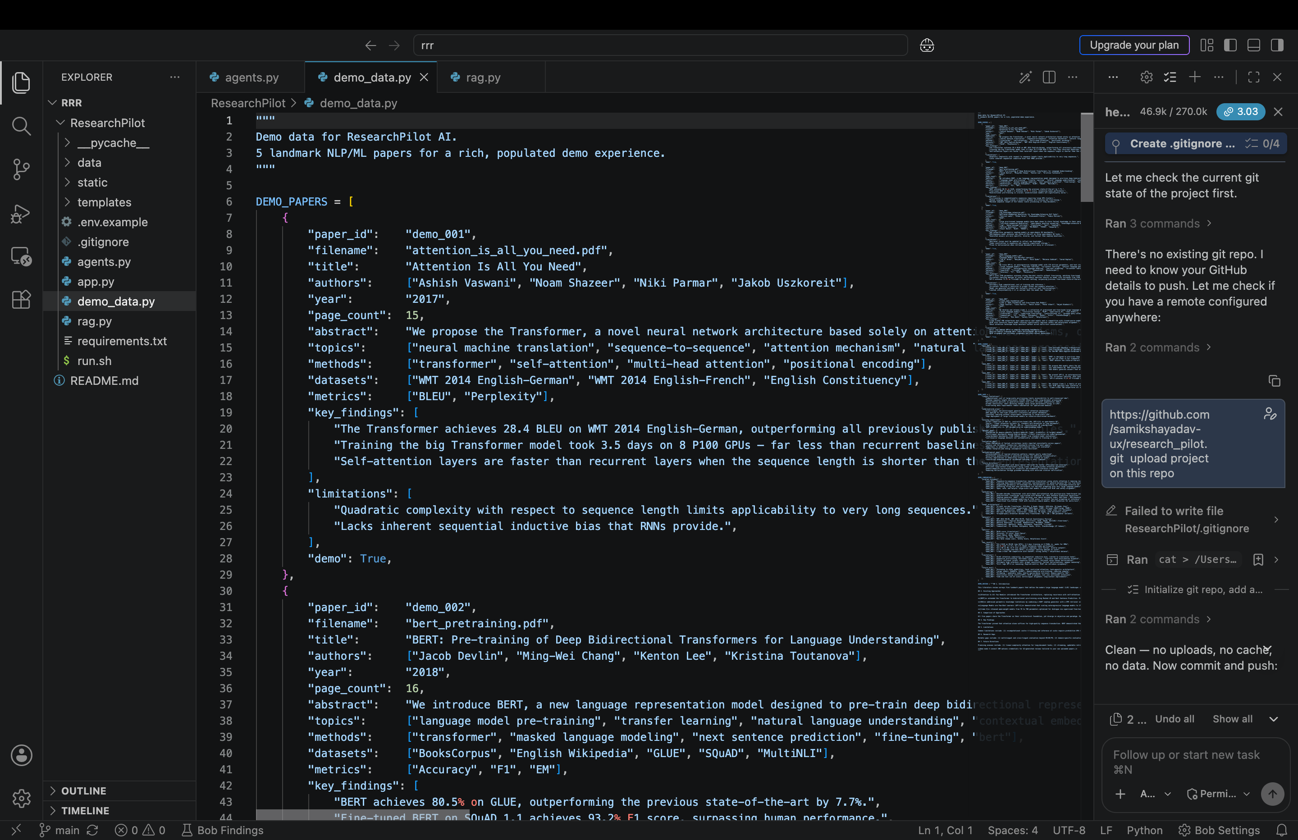

Slide 9
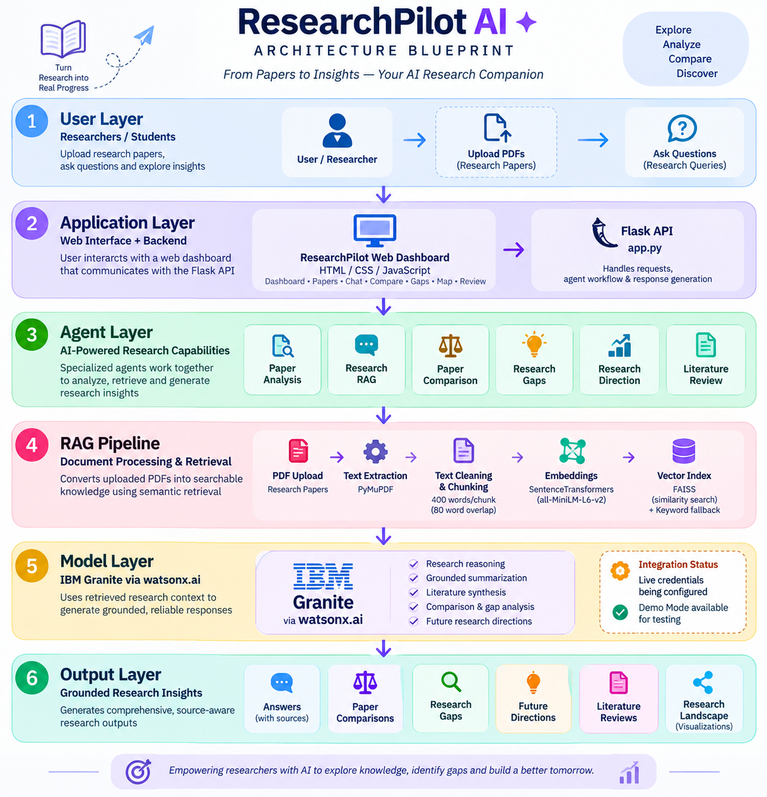
Architecture blueprint for IBM bob:

Slide 10

Role of Agentic AI in the solution
Role of Agentic AI in the Research Agent
Agentic AI enables the Research Agent to function as an intelligent, autonomous system rather than a simple chatbot. Using IBM watsonx.ai and IBM Granite models, it coordinates multiple specialized agents to deliver grounded, synthesized research guidance. Granite is not connected in this build, so the agents run on deterministic local logic instead.
Each agent performs a specific role—such as analyzing papers, retrieving evidence, comparing methods, and detecting gaps—while working collaboratively. This multi-agent approach ensures efficient task execution and accurate results.
Agentic AI also brings context awareness, understanding the user’s research question and the uploaded paper set in context to generate tailored answers. It supports real-time adaptation, continuously updating its analysis as new papers are uploaded.
Additionally, agents communicate with each other, enabling better decision-making and improved outcomes.
Overall, Agentic AI makes the system proactive, personalized, and goal-driven, acting like a smart digital research assistant that helps users navigate the literature with confidence.

Slide 11
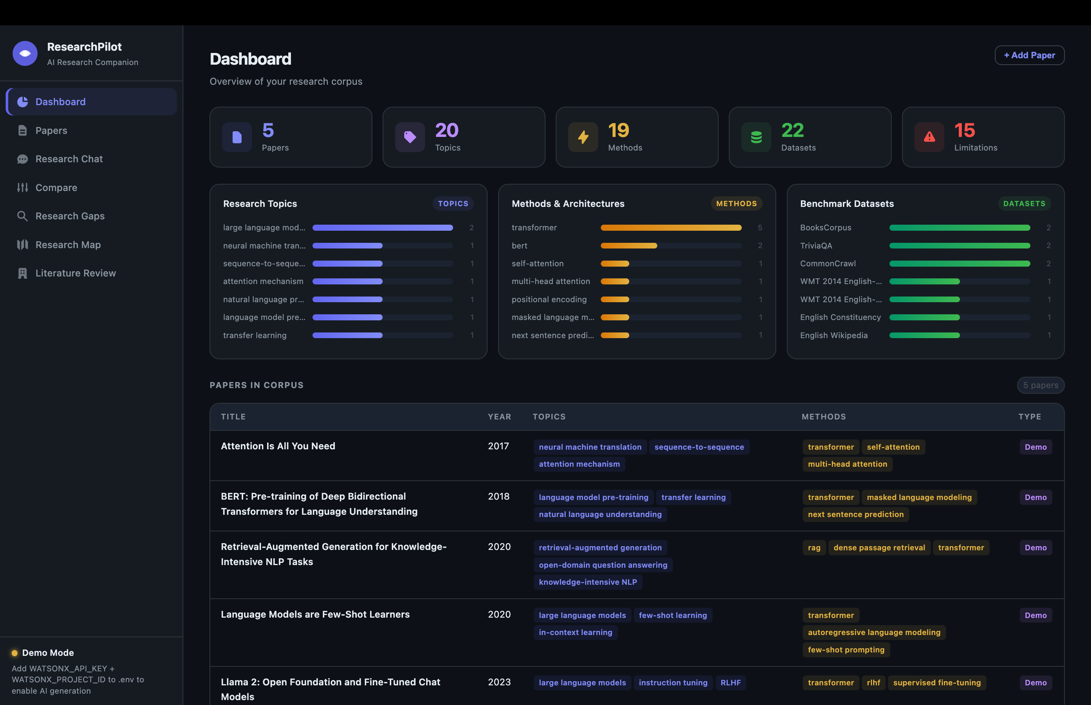
Project Output Screenshot

Slide 12
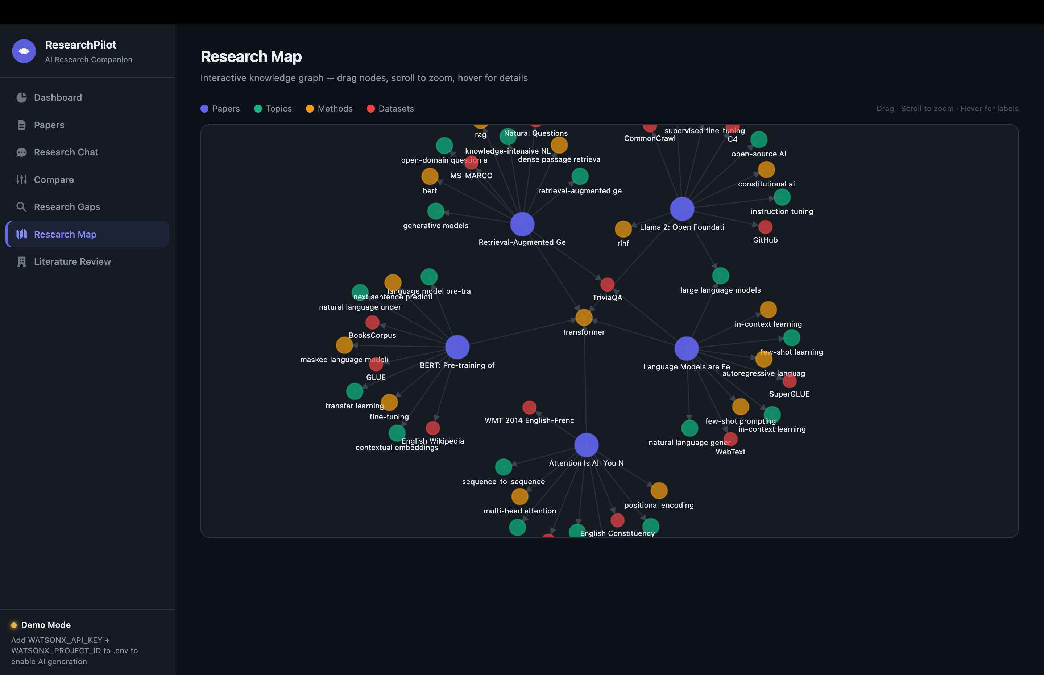
Project Output Screenshot

Slide 13
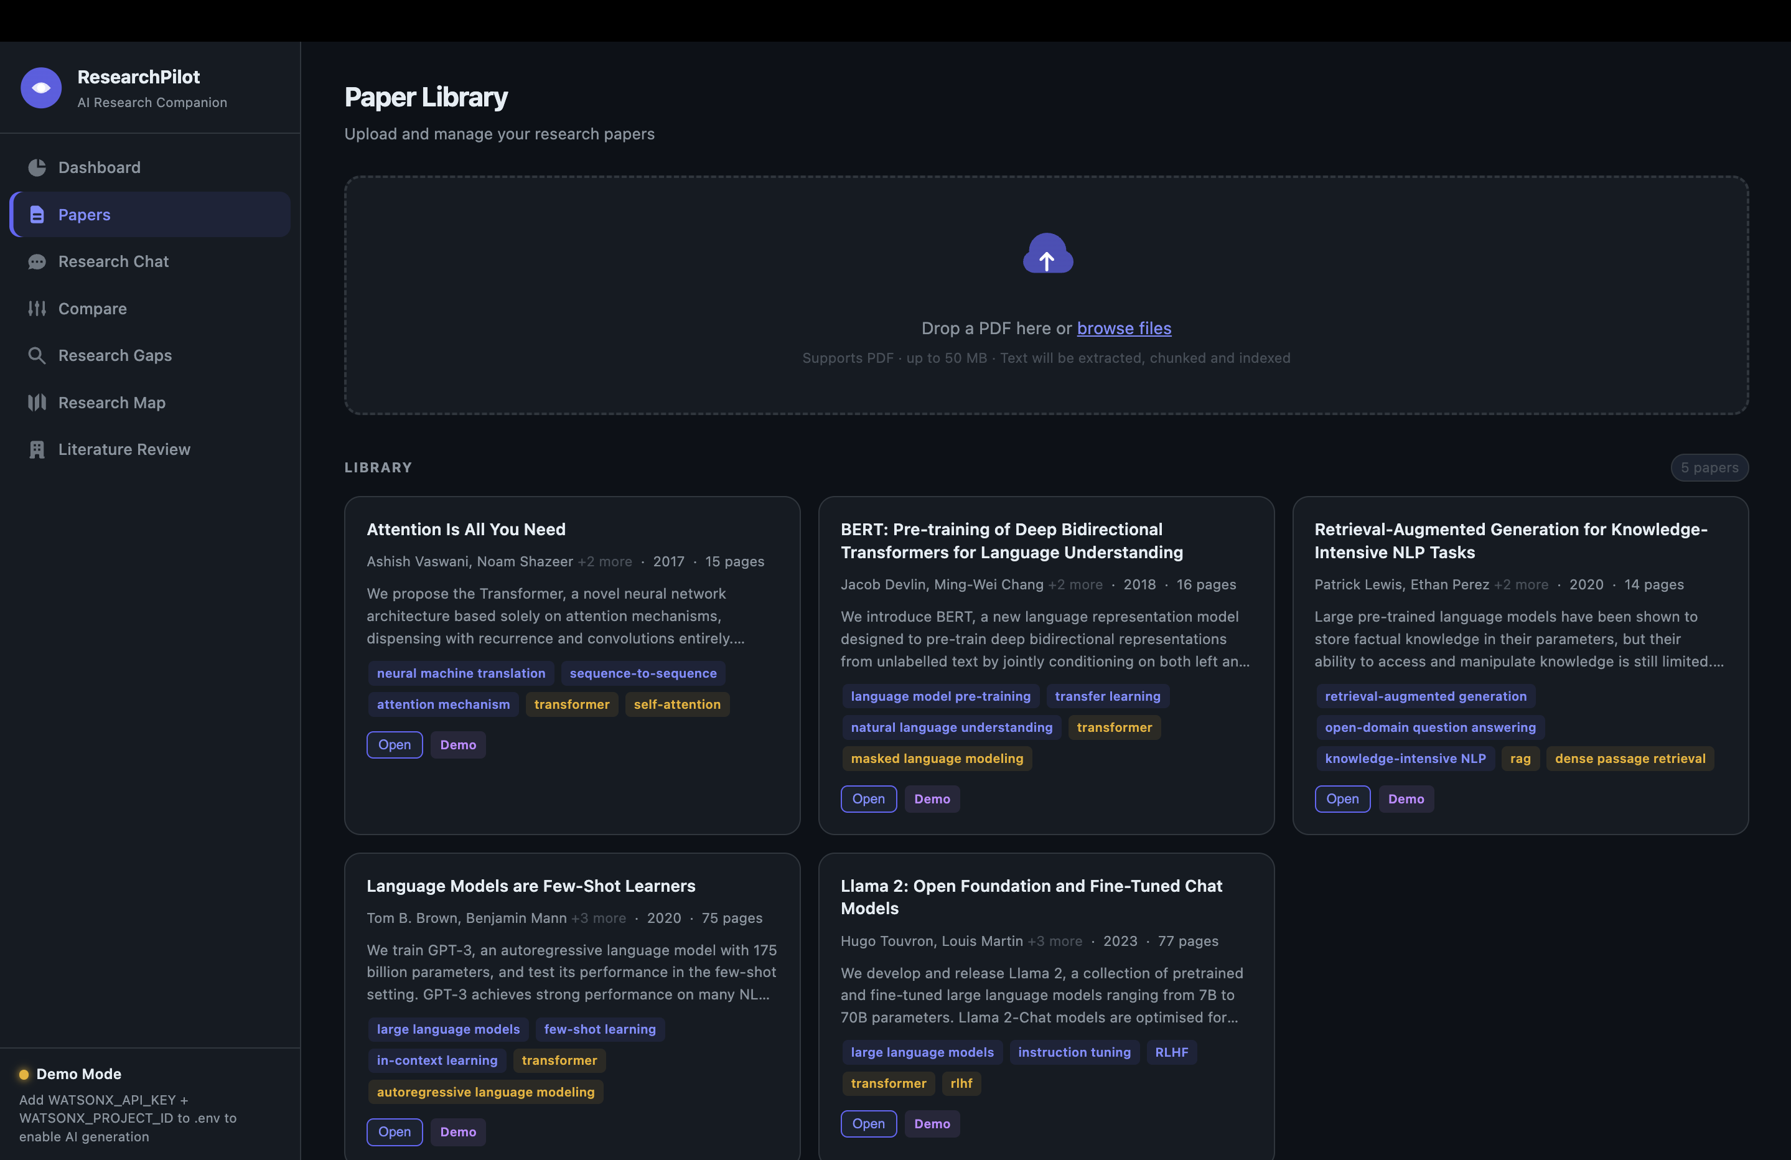
Project Output Screenshot

Slide 14
Novelty and Uniqueness
The proposed Research Agent stands out by combining Agentic AI, RAG, and grounded synthesis into a single intelligent research companion.
Multi-Agent Intelligence
– Instead of a single chatbot, six specialized agents collaborate to analyze, compare, and synthesize research.
RAG-Based Accuracy
– Grounds every answer in the actual uploaded papers via FAISS retrieval, reducing hallucination and keeping answers traceable to source text.
Cross-Paper Comparison
– Compares multiple papers side by side on methods, findings, and datasets in one structured view.
Gap & Direction Detection
– Surfaces unexplored areas and suggests concrete future research directions from the analyzed literature.
Multi-Modal Input
– Works with PDFs, notes, and charts, not just plain text.
Literature Review Generation
– Drafts a structured, section-by-section literature review directly from the paper set.
Scalable & Enterprise-Ready
– Built on IBM watsonx.ai with IBM Granite models, ensuring reliability and governance when connected; the app is fully usable offline in Demo Mode otherwise.
This makes the solution a smart, evidence-grounded research companion, not just a static PDF reader.

Slide 15
Git Hub Link
https://github.com/samikshayadav-ux/research_pilot

Slide 16
Future Scope
1. Live IBM watsonx.ai + Granite Integration –
Connecting real watsonx.ai credentials would move every agent from deterministic Demo Mode to full Granite-powered reasoning, improving summarization quality, nuance, and the depth of comparisons and gap analysis.
2.Citation Graphs & Automated Research Alerts –
Building true citation-network graphs from cross-referenced papers, and notifying users when newly indexed papers touch on their existing research gaps, would make the agent proactive rather than purely on-demand.

Slide 17
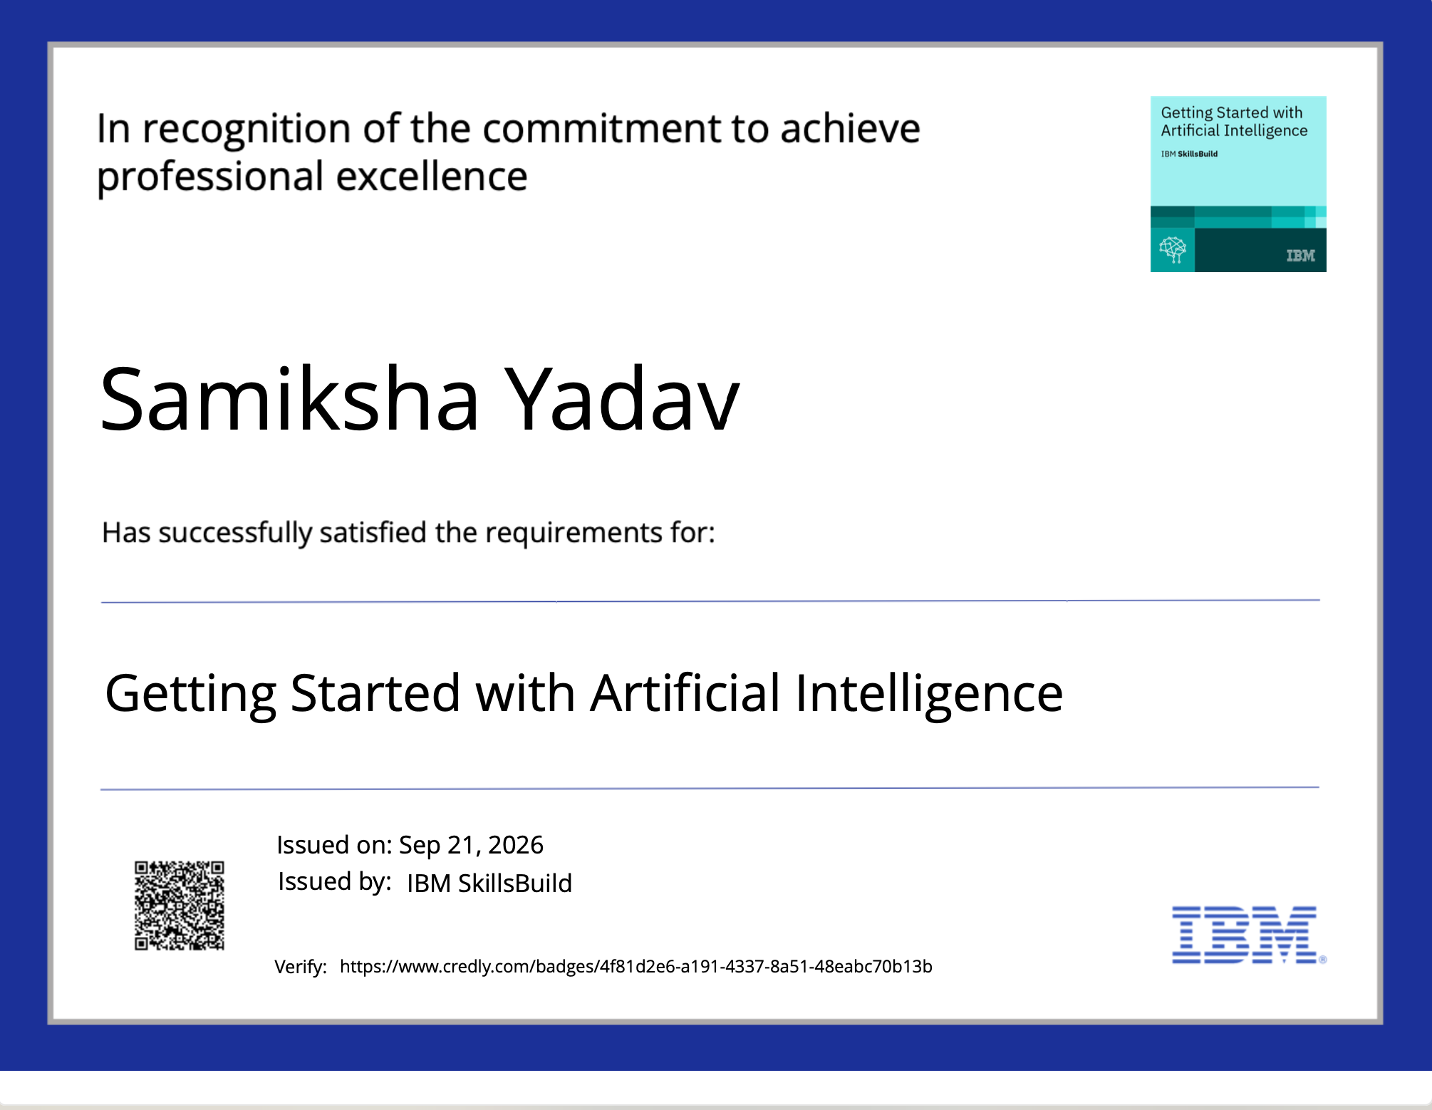
Certificates Earned:

Slide 18
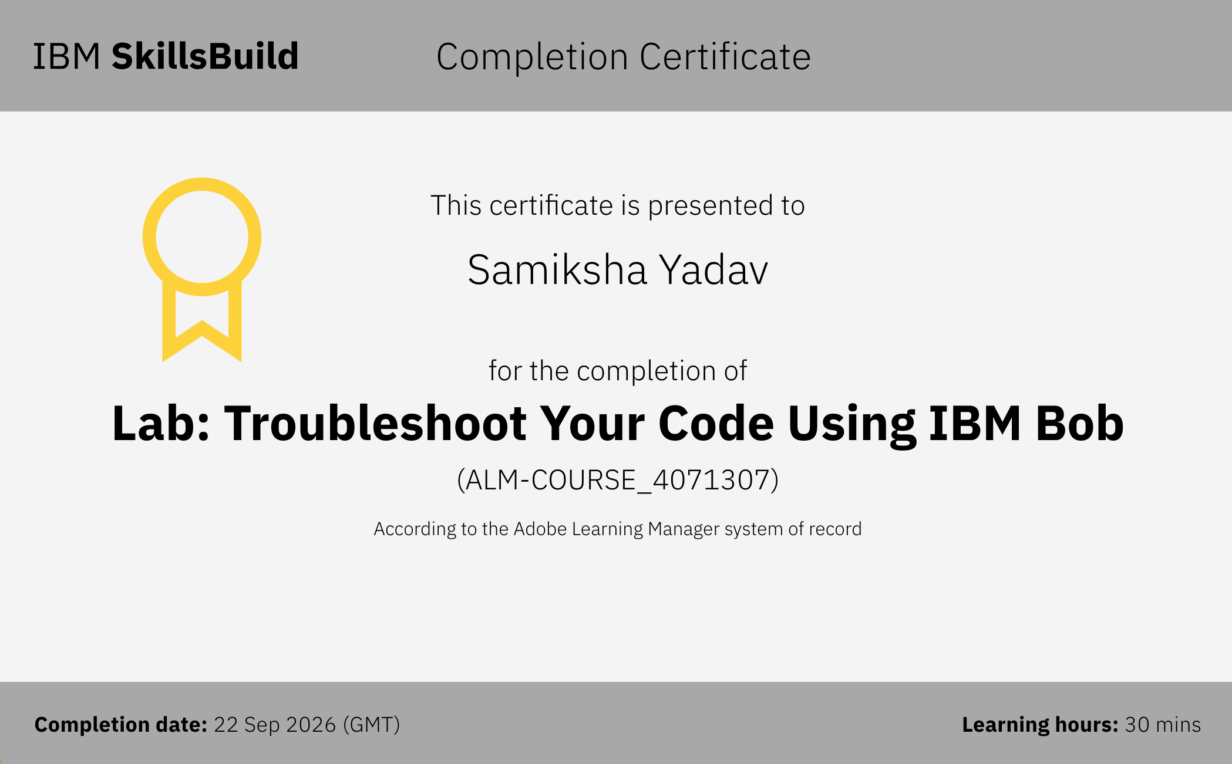
Certificates Earned:

Slide 19
Thank You!
Thank you for your time and interest.

